Slide 1
Cybersecurity Challenges in Transportation Systems
Anwesh Tuladhar
Ph.D. Student advised by Dr. Xinming (Simon) Ou
Department of Computer Science and Engineering
University of South Florida

Slide 2

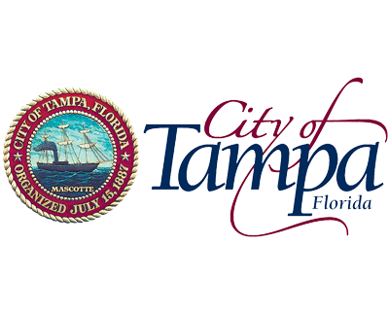
Acknowledgement
This research is supported by the National Science Foundation NSF CRISP Award No. 1638301:
CRISP Type 2: Integrative Decision Making Framework to Enhance the Resiliency of Interdependent Critical Infrastructures.
In collaboration with the City of Tampa Transportation Management Center

Slide 3

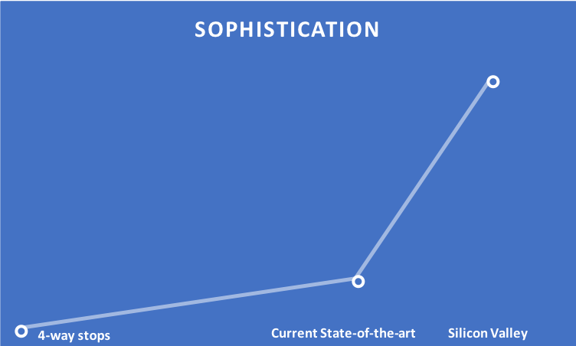
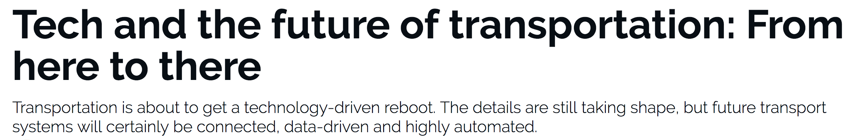
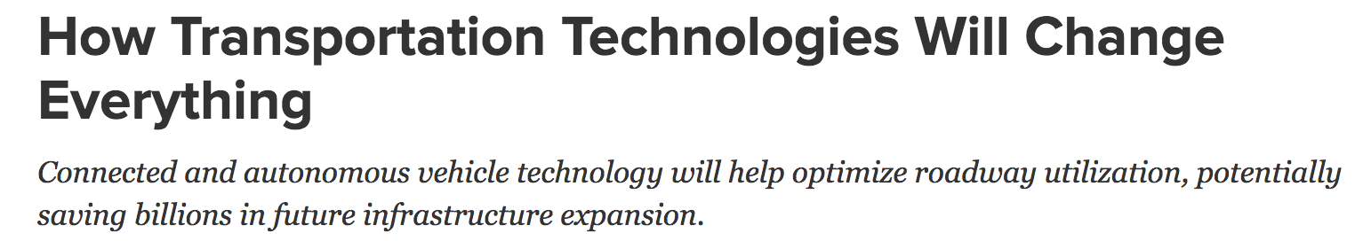
Motivation: Transportation and Technology
Current status
Adapt technology to fit the existing transportation infrastructure to improve usability and efficiency.
Emerging Trend
Connected vehicles technology
Autonomous vehicles technology
Transportation systems inherits the Cyber-security problem.
Notes:
As motivation, we look at the relationship between transportation and technology
Current Scheme:
The main underlying transportation infrastructure is the same. Use new technology that supplements the existing infrastructure to make it more usable and efficient.
Transportation infrastructure is driving the technology being used.
Eg. New software in the TMC for traffic engineers. New methods of vehicle detection, loop detectors to video detection. Use video detection to count cars to improve signal timing.
The growth is slow, compared to the growth in technology.
The technology used is not at the same level as the state of the art. (both in terms of hardware and software).
Emerging trend:
But transportation is moving towards these new technologies which come with a lot of big promises.
These are a giant leap forward compared to the current technologies.
The difference between these two technologies is vast.
The model of development is different.
The existing transportation infrastructure can no longer support the new features. In terms of compute power, software, …
Technology drives the transportation infrastructure.
Two important points to note here are that:
Sophistication
The difference between these technologies is huge.
The development model is also the opposite/With this, the roles of transportation and technology is changing(turning upside down). Now the cities have to adapt to the technology rather than the other way around.
This will help solve a lot of problems in transportation but Cyber security becomes a crucial problem as it is driving the physical world of transportation

Slide 4
Outline
Case study: City of Tampa Transportation Management Center
Overview of the current transportation system
Cyber risk analysis
Demo
Conclusion and Take away

Slide 5



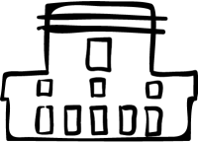
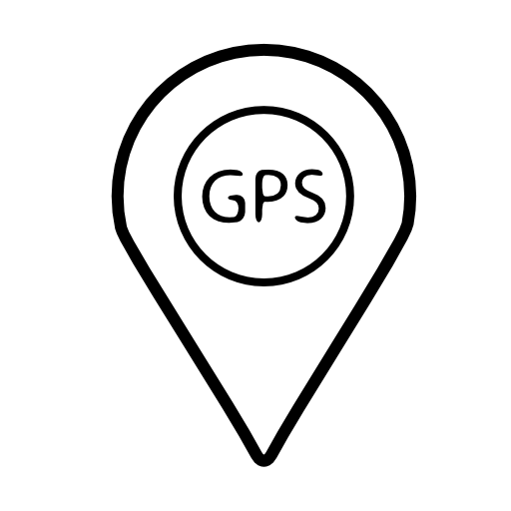
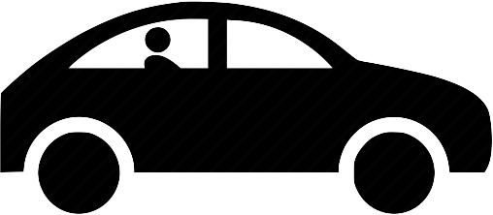

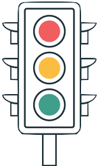
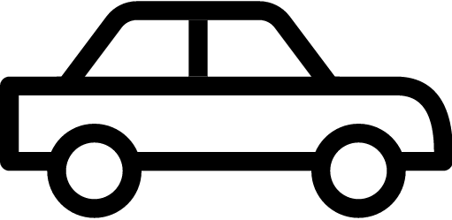






Overview of the Transportation System
Signal Cabinet
Intersection
Transportation Management Center (TMC)
Wireless
Communication
Connected/Autonomous Vehicles
TMC
Third Party Access (VPN)
Switch
Vehicle Detection
Server Room
Controller
Traffic
Lights
IP Video Servers
Application Servers
Database Servers
MMU
Human driven car
Pedestrian
Display
Wireless
Detector Card
Load
Switches
Signal
Cabinet
Pedestrian
Detection
Fiber
Optics
Internet
Terminal
Facilities
Terminal Facilities
Fiber Optics
Input
Input
Output
Output
Control Stations
Work Station
Inputs
Outputs
Fiber
Optics
Notes:
- We have humans driving cars and the traffic signals marshal the safe passage of cars through the intersection.
Intersection (What we see):
Currently only human drivers. Slowly we are getting to connected vehicles. In the future we will have autonomous cars.
Learned to do signal timing calculations for intersections.
Traffic flow is managed using traffic lights.
For better performance, we have vehicle detection systems and coordinated corridors.
For safety, we follow safety guidelines such as minimum yellow clearance, minimum red clearance, minimum pedestrian crossing time.
For monitoring, we have CCTV
These are controlled by the controllers in signal cabinet.
Signal cabinets = brain
Signal cabinets connected to the TMC
We have humans driving cars and the traffic signals marshal the car safely through the intersection.
The traffic lights are controlled by the signal cabinet (roadside unit).
The roadside unit takes physical world inputs using vehicle/ped detection to improve efficiency.
And we are now looking towards having connected and autonomous vehicles in the near future.
But there are other important parts to this system. The signal cabinet. These can be connected to other signal cabinets for coordination of a corridor and are also connected to a central Transporation Management Center(TMC).

Slide 6
Signal Cabinet
Wireless
Communication
Role: Control the intersection
Brain: Controller
OS: Linux(2.6.3x or greater) based
Driven by:
Programmed signal timing
Detector inputs
External requests: Transit Signal Priority (TSP), pre-emption (trains)
Ways to program:
Direct: Front panel, LAN connection with laptop, data-key, USB
Wireless: Wi-Fi Connection with tablet
TMC: Centracs, client applications
Watch dog: Malfunction Management Unit (MMU)
Role: Enforce the safety/conflict policies
Driven by: soldered circuit board
GPS: Account for time drift to maintain coordination
Communication: Fiber optics, wireless, twisted copper
Switch
Controller
MMU
Detector Card
Load
Switches
Terminal
Facilities
Terminal Facilities
Inputs
Outputs
Fiber
Optics
Notes:
Roadside boxes:
The brain of the system: Controller.. These are small computers in there own right. fairly advanced: linux based systems.
It controls all the analog hardware devices necessary for a functioning intersection.
https://www.cvedetails.com/vulnerability-list/vendor_id-33/product_id-47/version_id-19482/Linux-Linux-Kernel-2.6.3.html
Driven by:
Programmed signal timings
Detector inputs
External commands received (Transit Signal Priority)
Ways to program:
Direct: Physical access
Wireless: Close proximity
TMC: From anywhere
Controller can’t do anything it likes.
MMU (Watch dog):
Hardwired system that keeps the controller in check. (Physical access)
Makes sure the safety policies are followed.

Slide 7
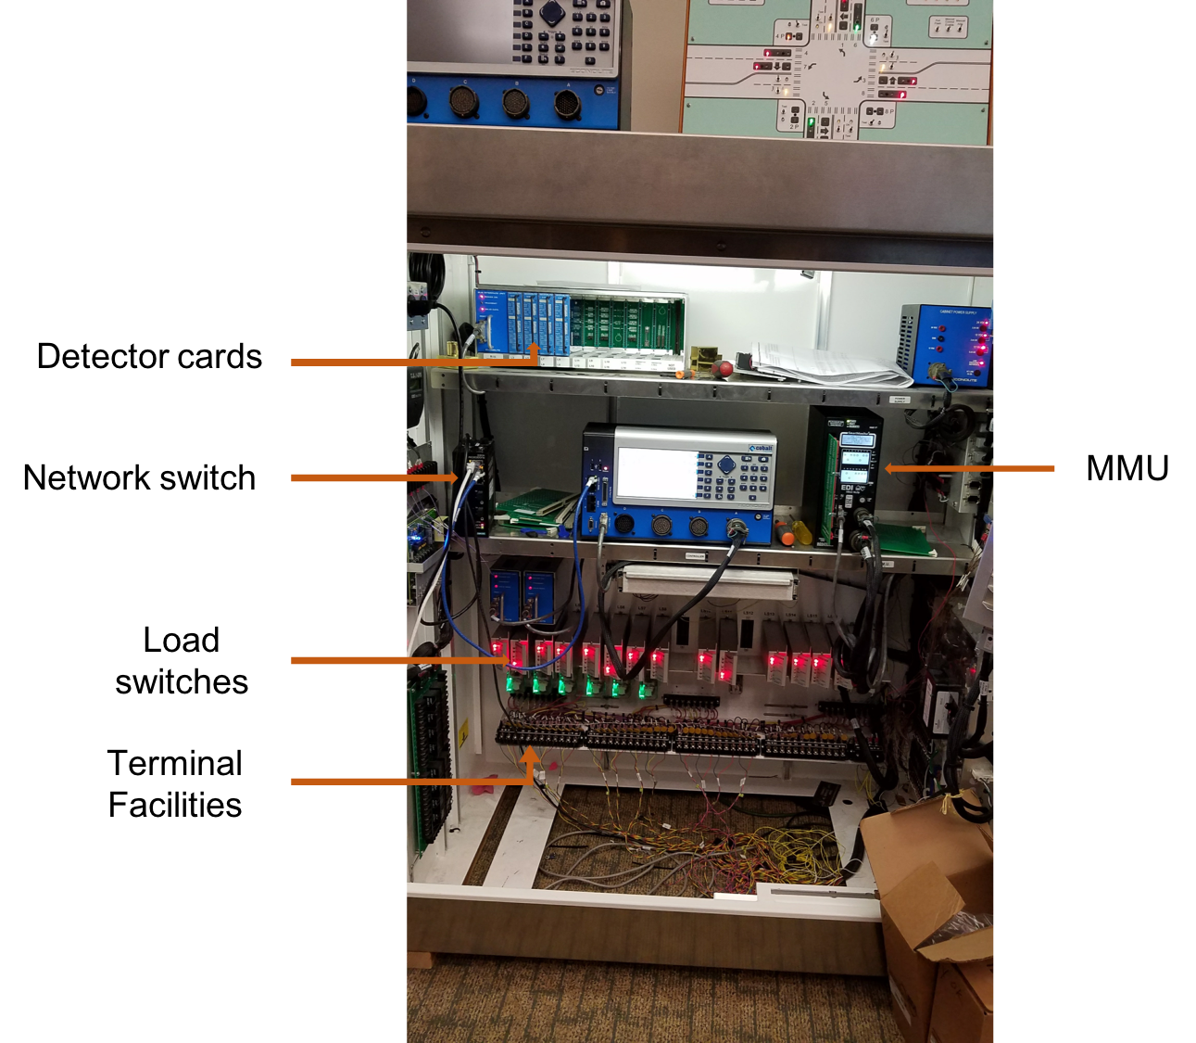
Signal Cabinet: Safety features
Controller:
Powered through MMU so that it cannot be taken out of the loop
Username and password (Not used).
3 access levels: administrator, data change level, data display level (Default is admin).
Has a backup database.
MMU:
Hardwired/soldered input.
Notes:
Username password not used: Multiple technicians need quick access
Backup database: to revert to a known good state.

Slide 8
Transportation Management Center (TMC)
Third Party Access
(VPN)
Role: Monitor and control ALL intersections
Communication:
Protocol: NTCIP level 2 compliant
Wireless: Mesh network, single hub in TMC can manage 20 spokes
Third party access through VPN
Applications:
MTCS:
MS-DOS based (legacy twisted copper support)
Command and Control type system.
If command and feedback vary: Controller runs it’s stored timings.
Centracs 2.0:
Advice and Consent type system (Controller is stand alone)
Can view status of each controller, view reports for single controller or for a zone, check logs
Connected Signals:
Mobile app that shows signal timings (red light notifier).
Have a network sniffer in the main switch.
Server Room
IP Video Servers
Application Servers
Database Servers
Wireless
Fiber
Optics
Internet
Control Stations
Work Station
Notes:
Advice and consent e.g. It takes around 3 cycles to switch a pattern.
National Transportation Communications for Intelligent Transportation System Protocol (NTCIP)
Usability aspect of technology comes into play here with the various applications.
These applications are used by traffic engineers for daily operations: signal timing and monitoring.
The leap in technology is massive. The same city with Connected vehicles pilot is still using an ancient DOS based system.

Slide 9
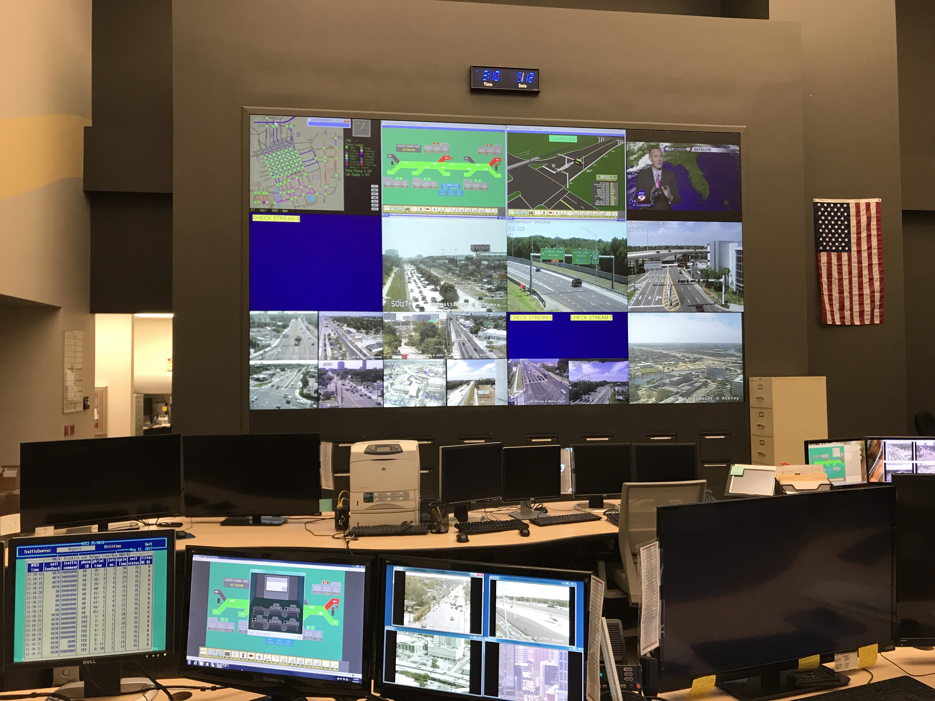
TMC: Safety features
Transportation network is isolated from the outside world.
Network:
Firewall
Virtual Private Network (VPN)
MTCS:
Easy detection of command and feedback inconsistence.
Centracs:
Username and password
Logs every change made to signal timing (version control like)
Provides alerts, logs and reports.
Notes:
No internet access in transportation network. The connection to all the roadside units is through a private network, not exposed to the outside world. This forms the backbone of current security.
Firewall: perimeter security
MTCS: Requires a human to monitor it.
Issues to discuss:
Is the firewall properly setup?
Does the software follow proper, secure practices? (encryption, input validation)
Is the software secure? (pen testing opportunity)

Slide 10
Risk Analysis: Intersection
Vehicle detection:
Cerrudo (2015) and Ghena et al (2014) have shown that wireless vehicle detectors can be hacked.
Impact: Congestion
Always runs a full cycle. Equivalent to a stuck pedestrian button.
Side street never gets serviced.
Resolution: Can be detected using monitoring tools (Waze, Bluetoad, CCTV)
Fiber optics:
Impact: Loss of communication.
Resolution: Easily detected.
Connected Vehicles:
Miller et al (2015) showed that cars can been hacked.
Challenges:
Vehicles get a bigger say.
More devices to hack.
Other issues:
Privacy issues.
Transmitting massive amount of data.
TMC
Connected/Autonomous Vehicles
Vehicle Detection
Traffic
Lights
Human driven car
Pedestrian
Display
Signal
Cabinet
Pedestrian
Detection
Input
Input
Fiber Optics
Output
Output
References:
Cerrudo, Cesar. "An emerging us (and world) threat: Cities wide open to cyber attacks." Securing Smart Cities (2015).
Ghena, Branden, William Beyer, Allen Hillaker, Jonathan Pevarnek, and J. Alex Halderman. "Green Lights Forever: Analyzing the Security of Traffic Infrastructure." WOOT 14 (2014): 7-7.
Miller, Charlie, and Chris Valasek. "Remote exploitation of an unaltered passenger vehicle." Black Hat USA 2015 (2015).
Notes:
Vehicle detection: Pretty safe. Requies humans to monitor for the resolution.
Semi actuated intersections: side streets may never get serviced.
With Connected vehicles in the picture, we have new challenges.
Change in paradigm. Shift from using your own trusted devices to detect vehicles to asking the vehicles themselves.
Basic Safety Messages (BSM) – 10 times a second.
2 channels in DSRC – one for critical and one for normal.

Slide 11
Risk Analysis: Signal Cabinet
Wireless
Communication
Wireless Communication:
Outcome: Gain access to controller.
Resolution: Disable SSID broadcast, enable encryption, do not use default configuration/credential
Controller:
Ghena et al (2014) have shown it can be compromised.
Outcome: Change signal timing, update firmware.
Impacts: Congestion, diminished safety
But MMU maintains safety.
Resolution: Disable debug port, enable password protection, enable access control
Network:
Outcome: Gain access to all communication
Impacts: Denial of Service (DoS) attack
Resolution: Firewalls
Switch
Controller
MMU
Detector Card
Load
Switches
Terminal
Facilities
Terminal Facilities
Inputs
Outputs
Fiber
Optics
Notes:
Wireless communication:
resolution is maintain/make it hard to break the isolation criteria.
Controller compromise using debug port.
Tie it with the physical, proximity or TMC access mentioned before.
Wireless: Not very prevalent. (Fiber optics preferred)

Slide 12
Risk Analysis: TMC
Third Party Access (VPN)
Control stations:
Social engineering.
Third party access:
Are they following security practices?
Outcome: Access to entire infrastructure.
Server Room
IP Video Servers
Application Servers
Database Servers
Wireless
Fiber
Optics
Internet
Control Stations
Work Station
Notes:
- The goal of the malicious actor is to get to the Controller. Then he can affect the traffic.
“An Operational Data Environment is a real-time data acquisition and distribution software system that processes and routes data from Connected-X devices – including connected vehicles (CV), personal mobile devices, infrastructure components, and sensors – to subscribing applications to support the operation, maintenance, and use of the transportation system, as well as related research and development efforts.”
“While provisioning data from data sources to data users, the ODE also will perform necessary security / credential checks and, as needed, data validation and sanitization.”
Future challenges:
Operational Data Environment (ODE) for connected vehicle platform will create a much higher work load and will be open to many more attack vectors.
Security must be built in from the beginning.

Slide 13
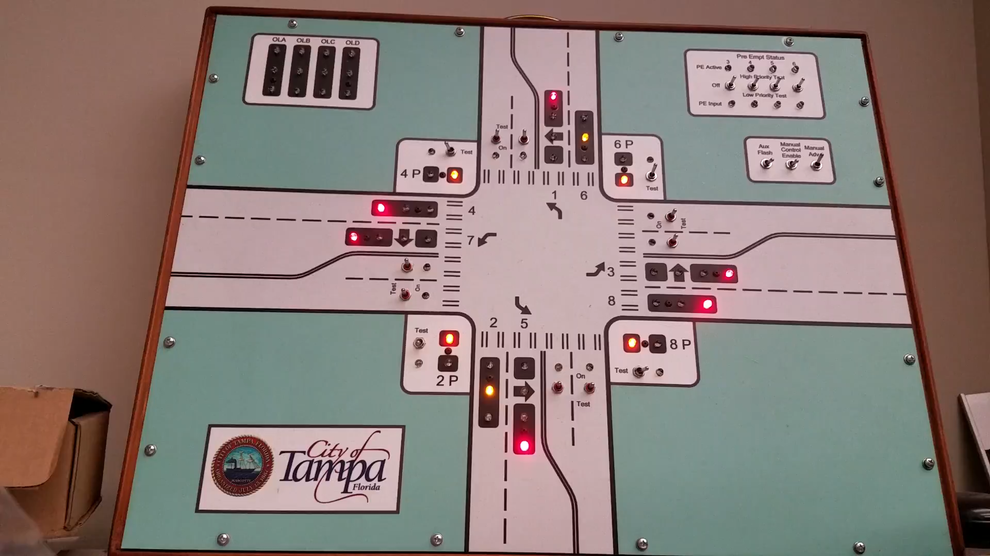
Demo
Notes:
Describe the setup. 4way intersection, connected to the signal cabinet with the MMU supposedly enforcing safety properties.
MMU enforces safety policies
Disallows conflicting green lights.
Enforces minimum amber(yellow) and red light periods.
Even playing by the book, we can induce certain unsafe conditions by limiting the green light period to 1 sec, as in the demo.

Slide 14
Conclusion
Cybersecurity is currently not a major concern for transportation systems.
reliance on the isolated network and physical protection of devices.
i.e. all the systems are within the trust boundary.
However existing architecture poses serious cybersecurity threats for the emerging transportation technologies.
With connected and autonomous technologies, the isolation assumption is no longer valid.
Plus the gap between current and emerging technologies is vast.
The stakes are much higher in transportation than in traditional IT systems.
Notes:
But with the connected and autonomous vehicle technology, this assumption is no longer valid.
We are at an inflection point in this curve. The design pattern is changing.
Technology gap is vast:
Remember that transportation is getting a technology driven reboot.
This makes it harder.
Exposing congestion attack on emerging connected vehicle based traffic signal control. https://pdfs.semanticscholar.org/2f41/0fd80f5468307647432d95ec5f268ac1db11.pdf

Slide 15
Questions ?

